Slide 1
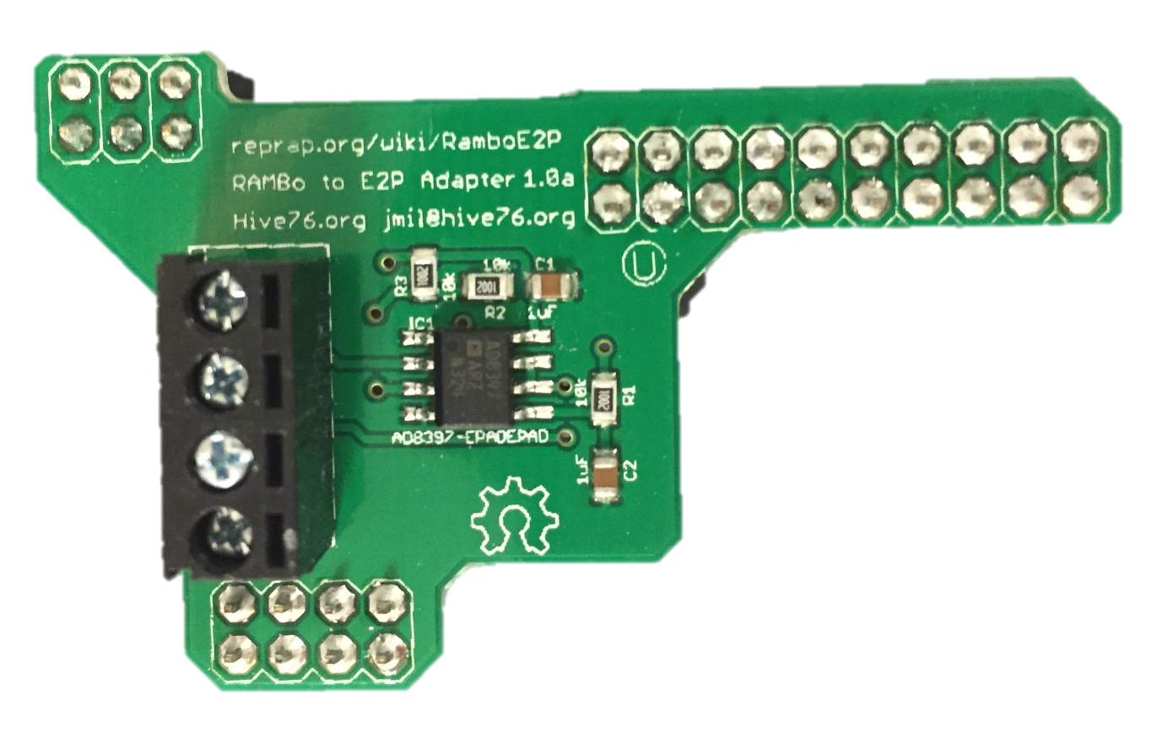
Z endstop
X endstop
Y endstop
USB Connection to PC
PWM-Voltage Transducer
Solenoid Valve
RAMBo v1.2
Optional heated bed
See zoomed in view of motor ext pins
+ - + - + -
Electropneumatic (E/P) transducer
RAMBo power supply: 12V DC; 30A
Important: RAMBo and ShopBot need common ground
ShopBot 48V built-in power supply

